Slide 1
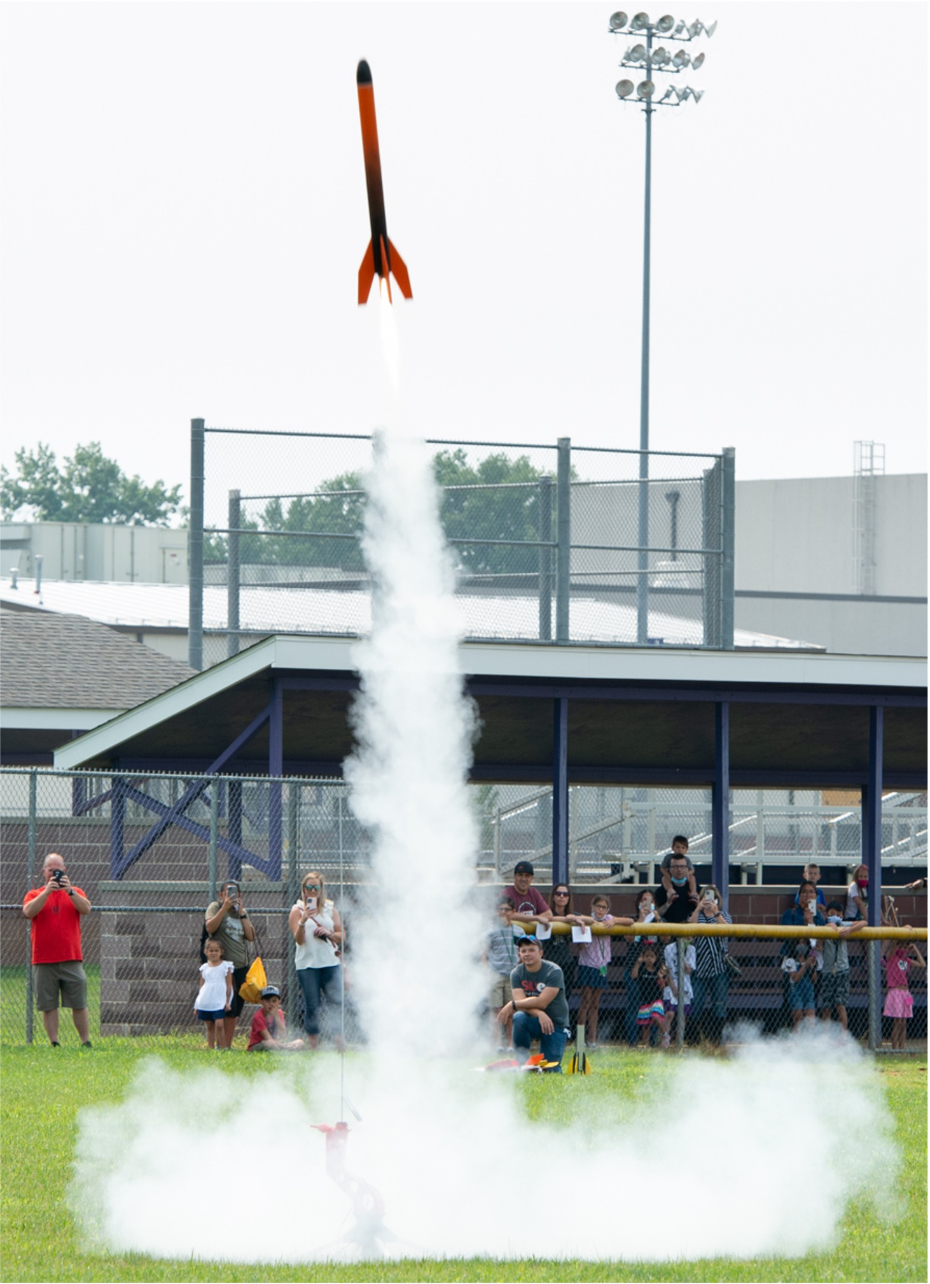
Single-Stage Rocket (SSR)
Build Instructions

Slide 2
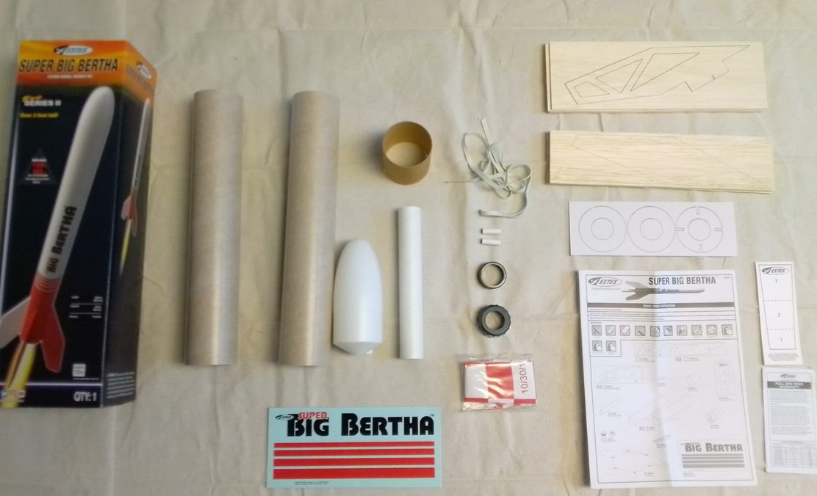
Parts needed
(1) Estes Super Big Bertha Rocket Kit
Motor mount tube
(2) Centering rings
(1) Notched centering ring
(2) Body tubes
E/F. (8) Laser-cut wood sheets
G. (4) Laser-cut wood sheet
(2) Launch lugs
Tube coupler
Nose Cone
K/L. Engine retainer set
Shock cord
Parachute
Shock cord mount
G
I
E
M
F
H
K
B
C
L
O
J
A
D
N

Slide 3
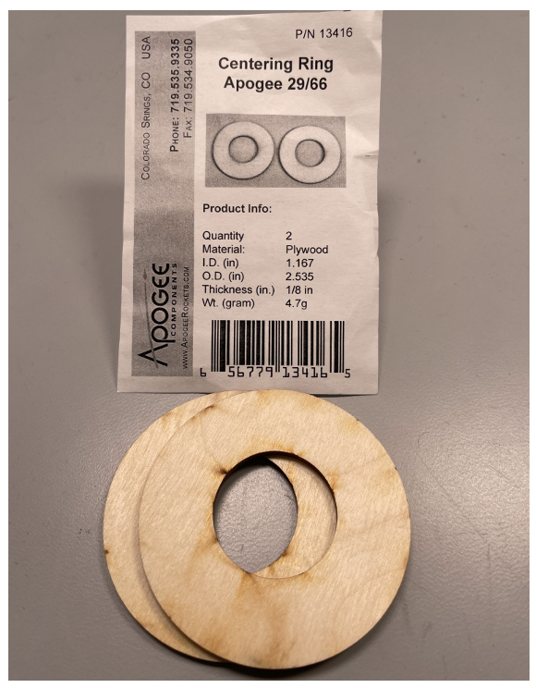
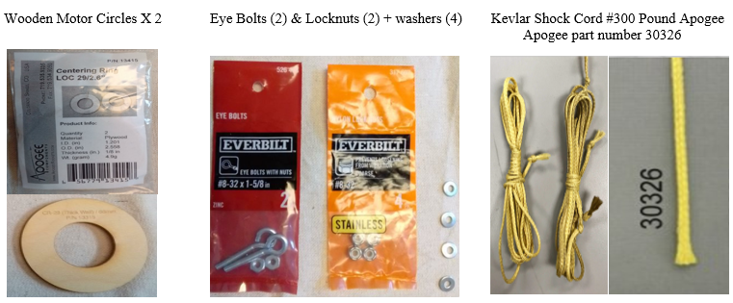
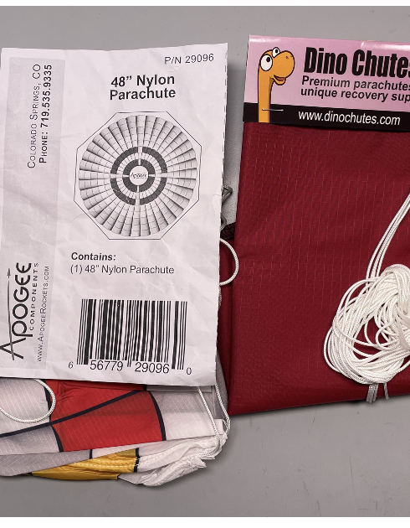
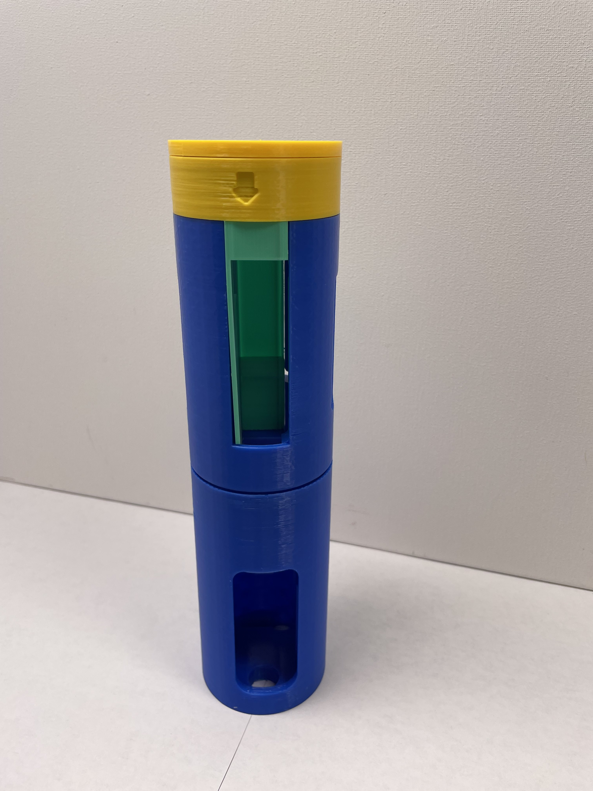
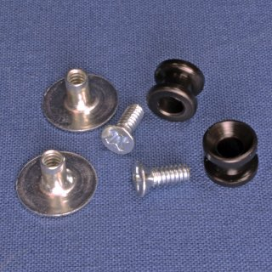
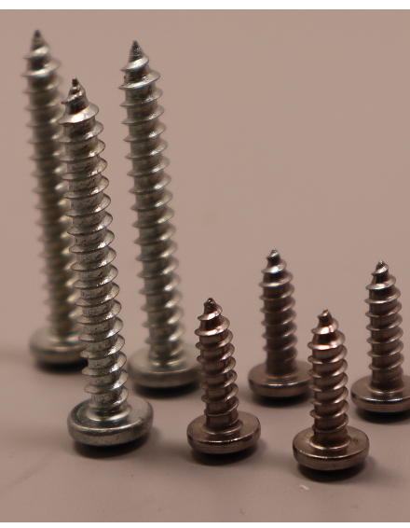
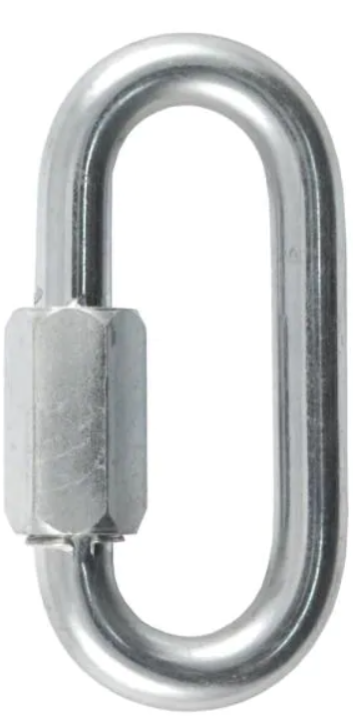
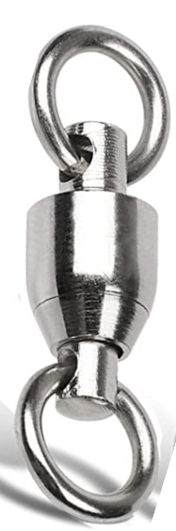
Additional parts needed
P.
(1) Wooden centering ring, (Apogee, #13416)
T.
300-lb. Kevlar shock cord, length = 3 times the length of the rocket body + 6”, (Apogee, #30326)
X.
Avionics/electronics bay (3-D print files provided in Microcontroller Electronics kit.)
AA.
(1) Ripstop nylon parachute. Any chute between 30” and 48” is acceptable.
Q.
R.
S.
(1) #8-32 x 1-58” Eyebolts
#8-32 Stainless steel nylon lock nuts
(2) #8 Zinc flat washers
U.
V.
(1) 1/8” quick link
(1) 275-lb. ball bearing swivel
Y.
Z.
(4) #8 Screws, shorter ( ½” long)
(3) #8 Screws, longer (3/4” to 1” long)
BB.
Rail buttons
W.
(3) 2.561 outer-diameter wooden bulkhead disks, (1) of the included eyebolts will be used

Slide 4
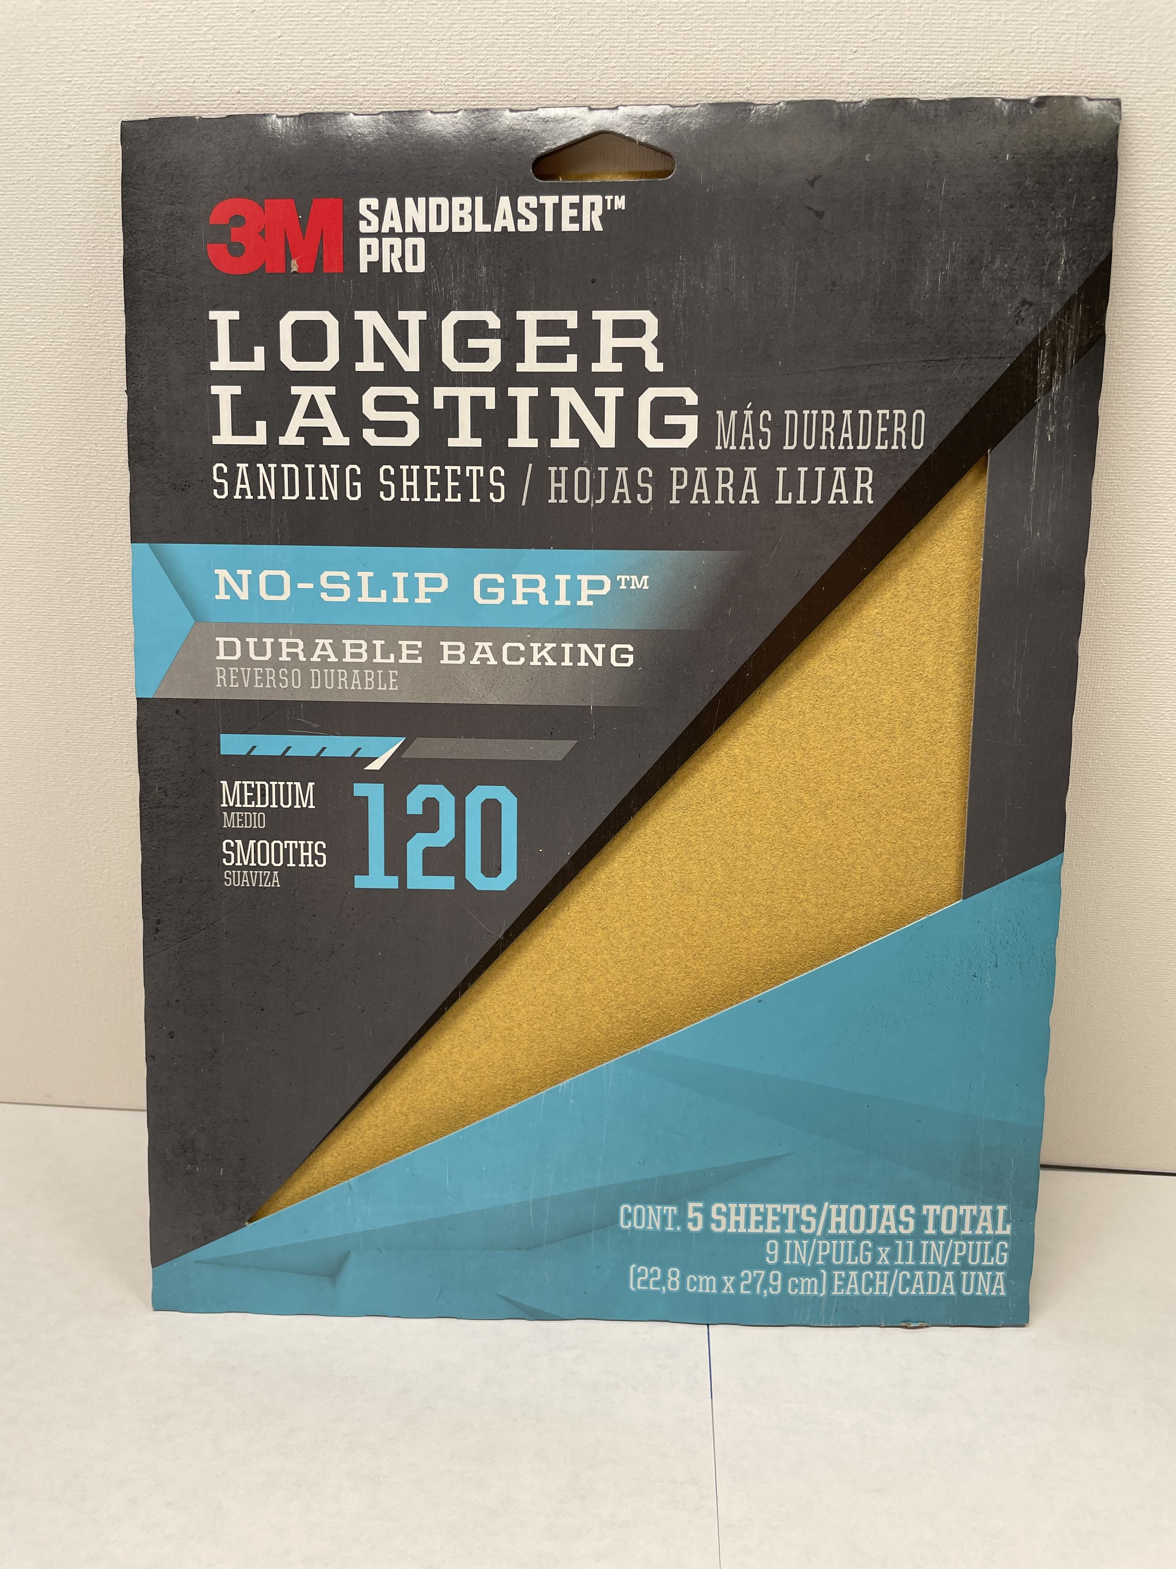
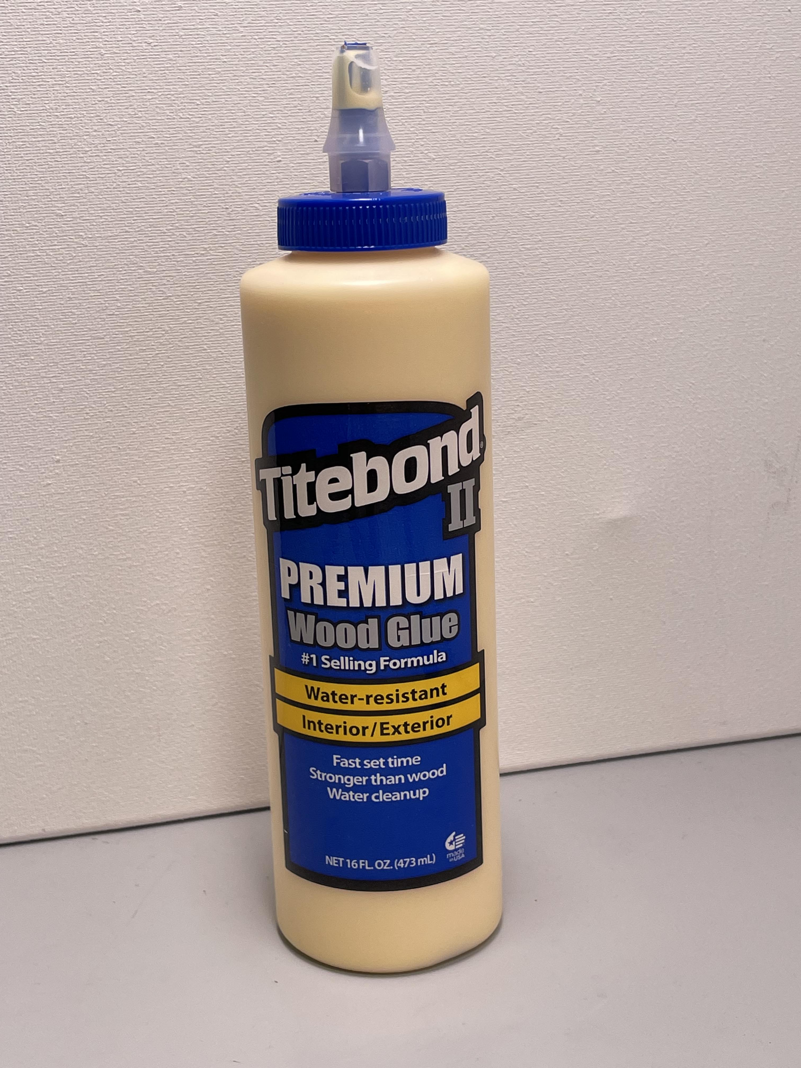
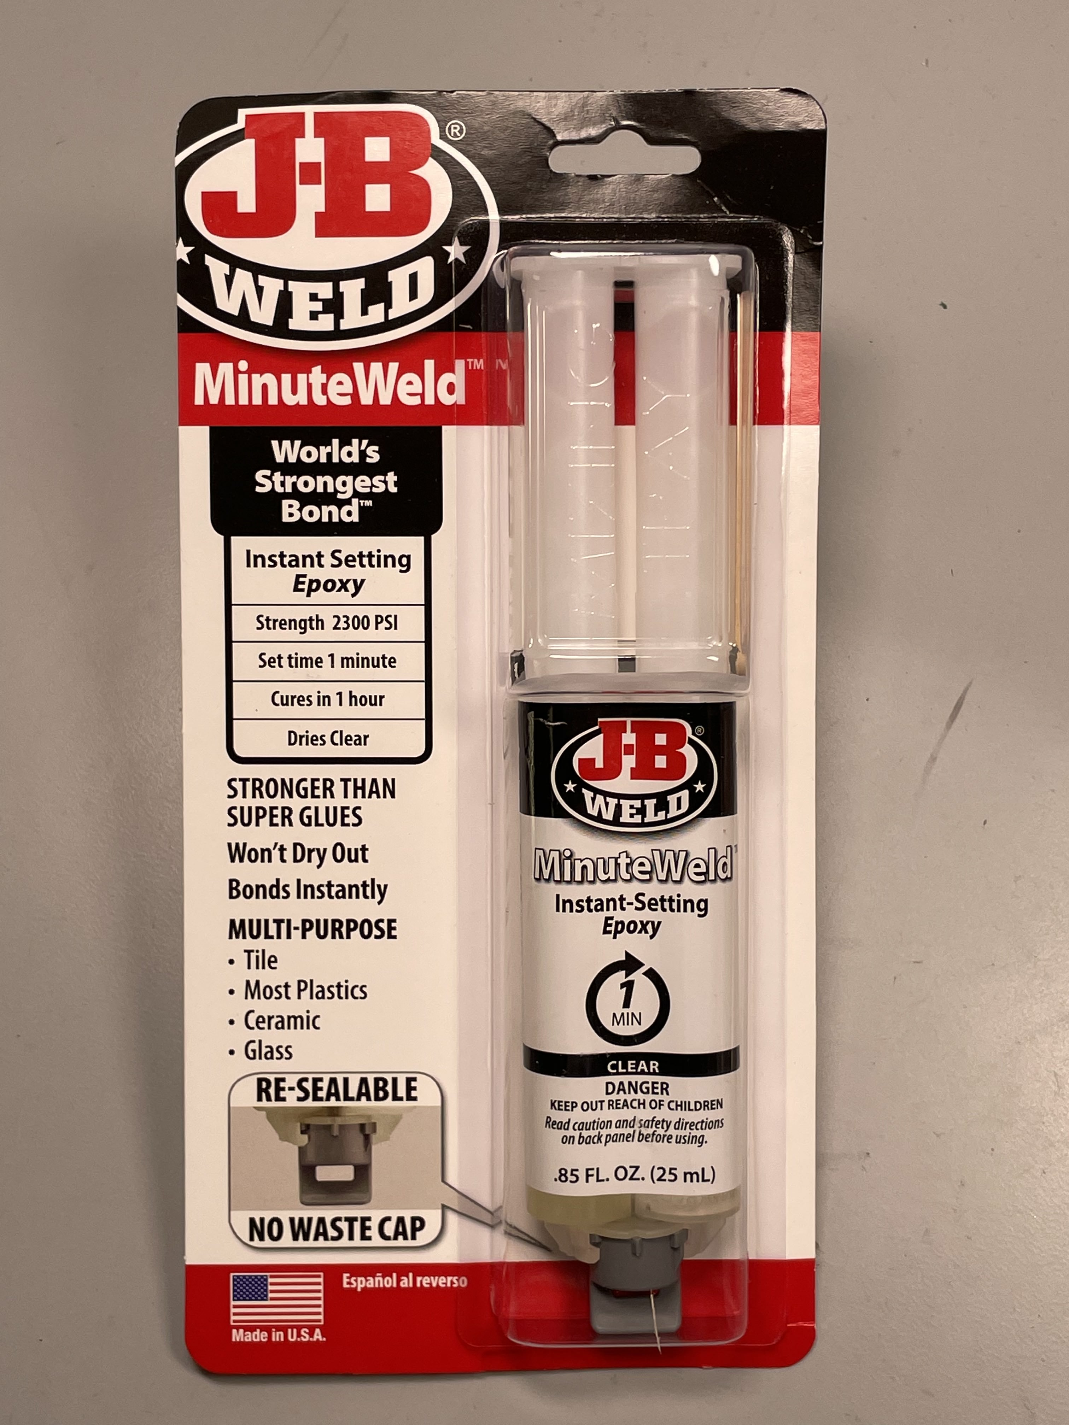
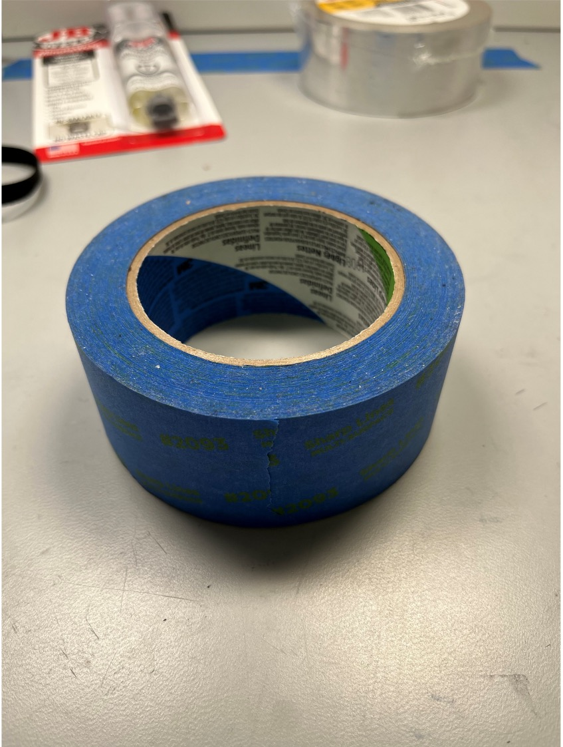
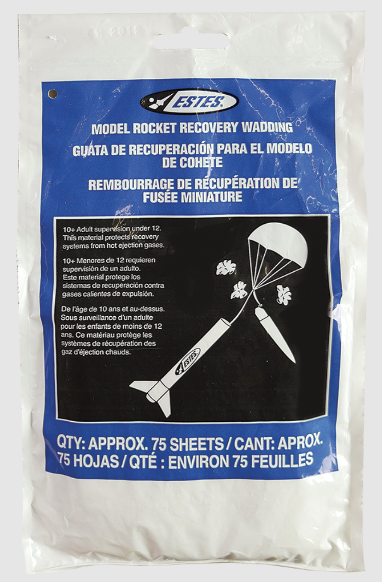
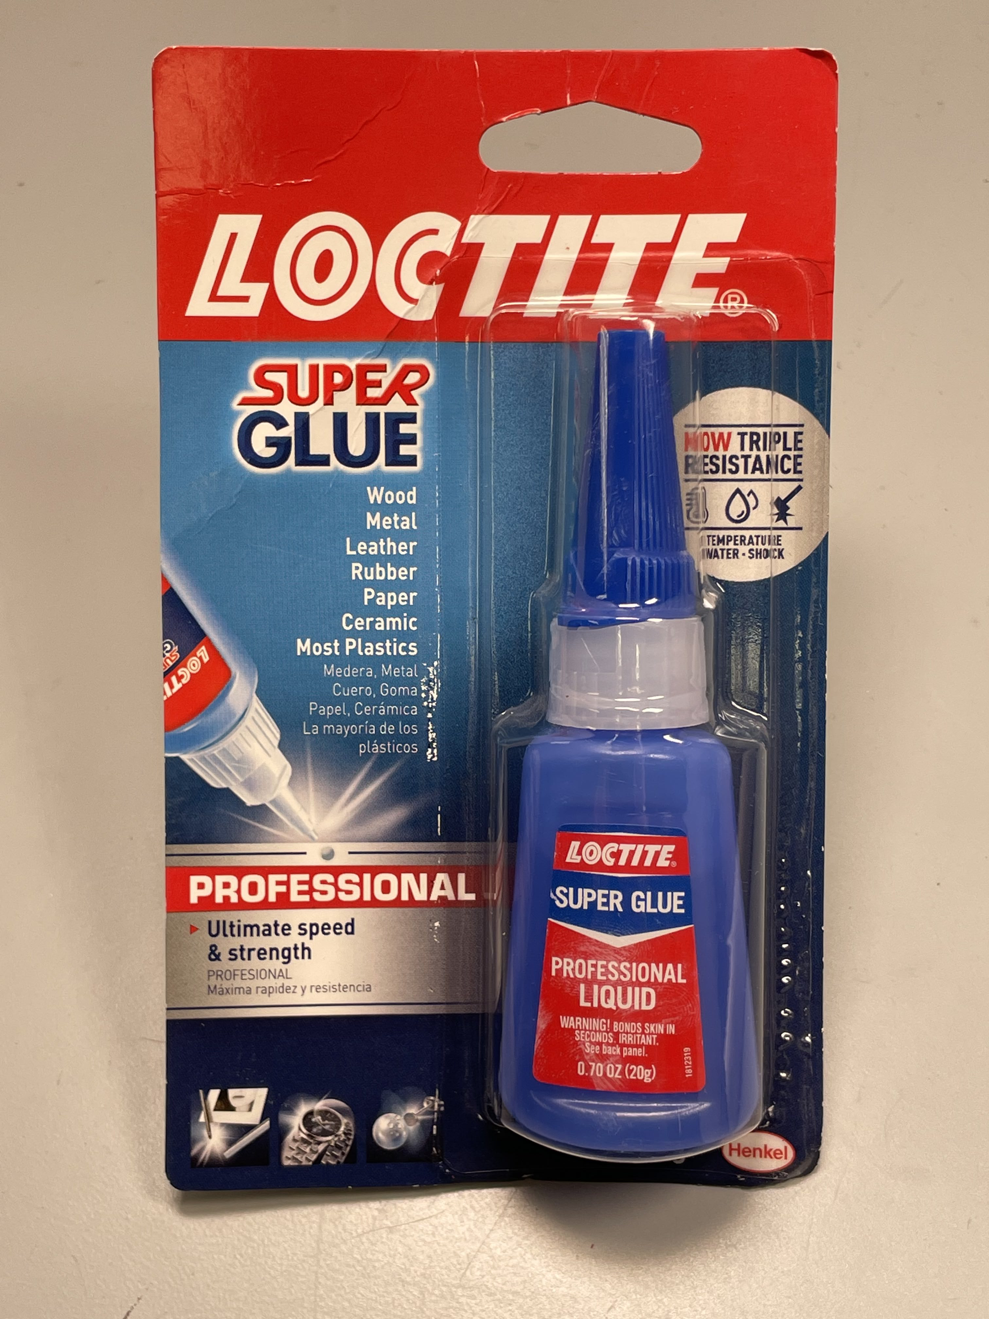
Additional materials needed
Consumables
Tools needed
Wood glue
2-part epoxy
Drill with 1/8” and 1/2” bits
Screwdriver
X-acto or other craft knife
Scissors
Clamps
Ruler
Pencil
Long needle-nose pliers
Adjustable wrench
Socket wrench with socket that fits the lock nuts (R)
Optional:
Hacksaw
Mitre box
Sandpaper
Painter’s tape
Super glue
Recovery wadding

Slide 5
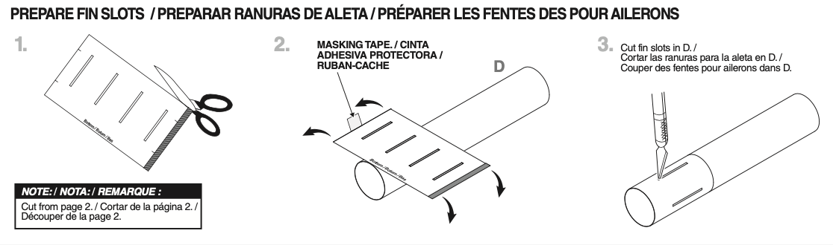
Step 0
0.1
Read through all instructions before beginning step 1.
0.2
Cut out the fin-slot guide sheet inside the Estes kit instruction manual on page 2. Retain this template for Step 3.
To avoid confusion, discard the rest of the Estes instructions.
Estes Super Big Bertha Model Rocket Instructions, Estes Industries, LLC, Penrose, CO, 2019, p. 3

Slide 6
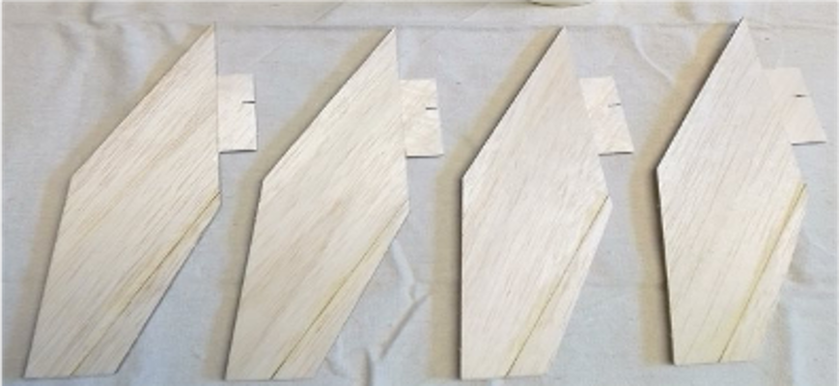
Step 1:
Prepare rocket fins
Estes Super Big Bertha Kit parts E, F, G
Craft or X-acto knife
Sandpaper
Wood glue
Super glue
*Clamps
*Optional

Slide 7
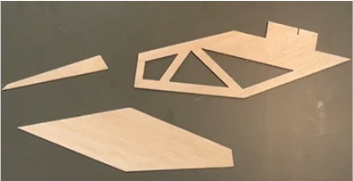
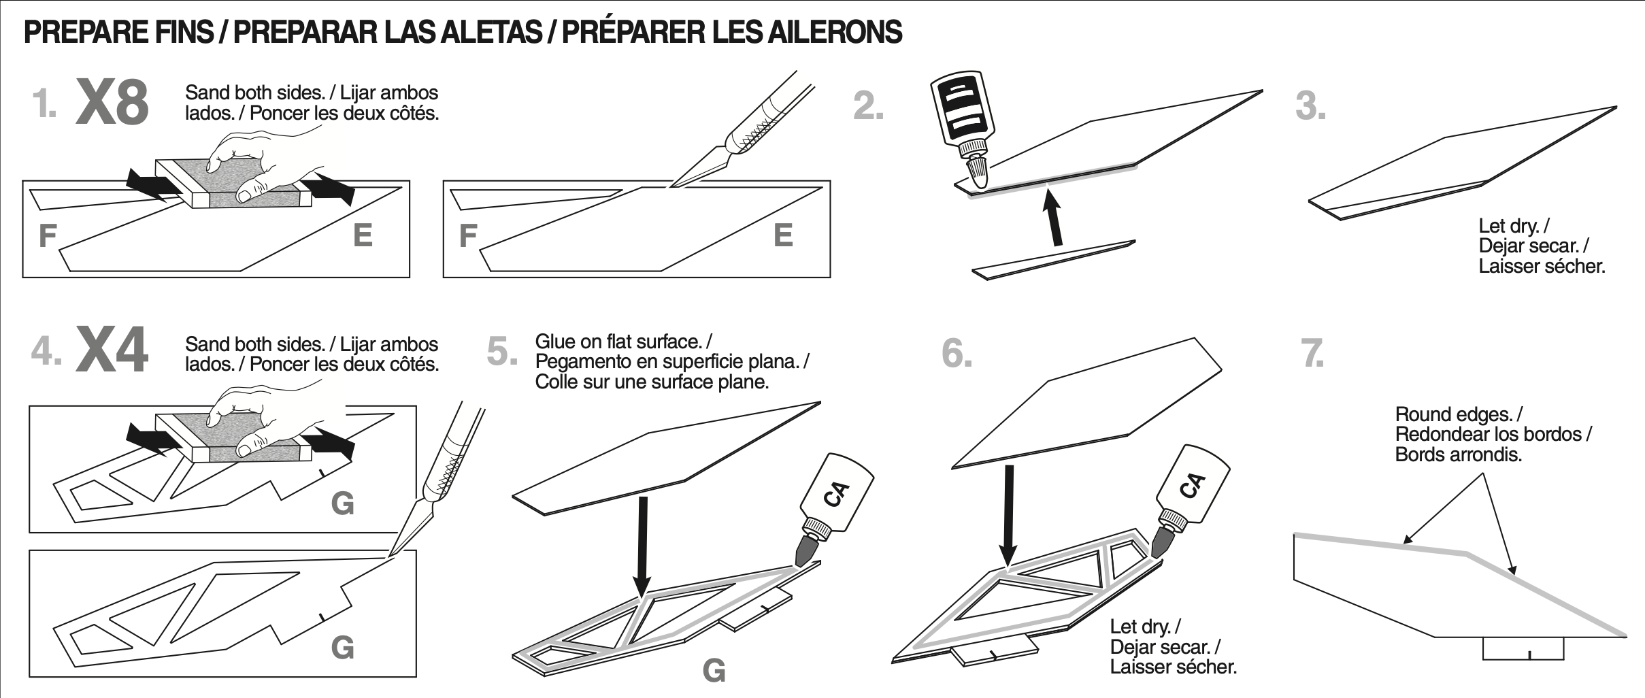
Step 1:
Prepare rocket fins (cont’d)
1.1
Break all components (parts E, F, G) out of the balsa wood sheets, using a craft knife if necessary. Lightly sand both sides of all components.
Save the waste balsa as you may wish to use it as a tool in later steps (such as using it to apply/scrape off glue).
1.2
Step 1 goes fastest if you treat it like an assembly line, completing each sub-step for all fins at one time.
Glue together parts E and F so that your outer fin looks like the one in picture 3. Repeat until you have 8 total fin covers. You may find clamps useful to position the fins as they dry.
Allow about 5 minutes for the glue to begin drying on a fin before you manipulate it for the next step.
Estes Super Big Bertha Model Rocket Instructions, Estes Industries, LLC, Penrose, CO, 2019, p. 3

Slide 8

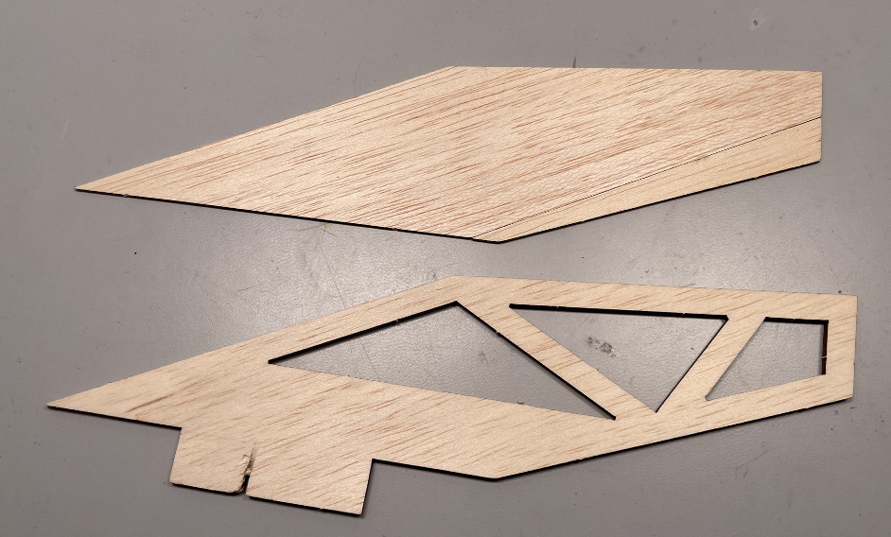
Step 1:
Prepare rocket fins (cont’d)
Super glue sets and dries in seconds. Make sure to apply the glue and position the fins quickly. Once the fins are in place, you will not be able to move/slide them, so be sure to prepare and position your pieces before you start gluing.
CAUTION
1.3
Dry fit the inner fin ribbing (G) with a fin cover assembly from step 1.2. Place them next to each other in exactly the orientation they will have once glued.
Apply a bead of super glue (also known as CA) across the surface of the inner fin ribbing. Quickly place the outer fin cover on the inner fin ribbing.
Turn the assembly upside down and repeat for the other side of the fin.
At the end of this process you will have four fins.
Estes Super Big Bertha Model Rocket Instructions, Estes Industries, LLC, Penrose, CO, 2019, p. 3

Slide 9
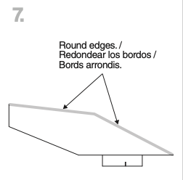
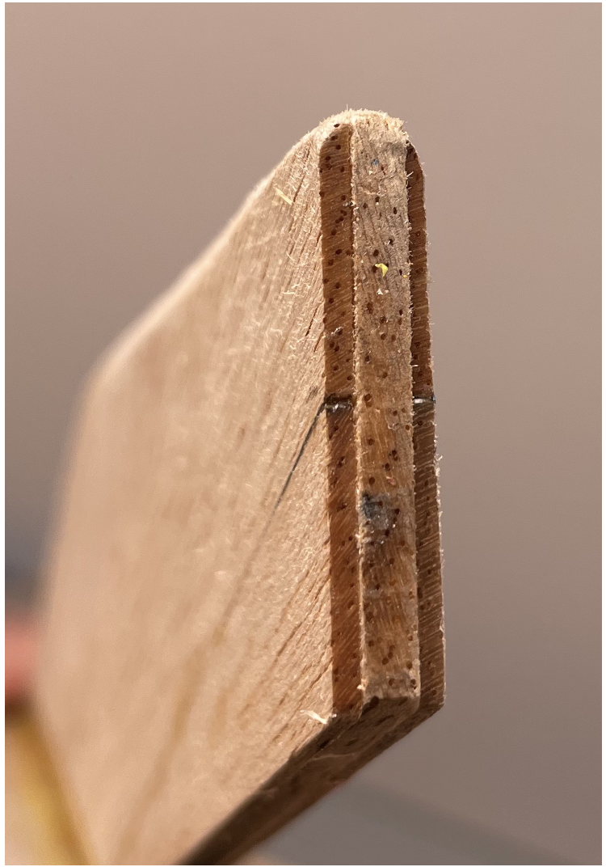
Step 1:
Prepare rocket fins (cont’d)
1.4
Once the fins are dry, use sandpaper to round the fins along the what will be the leading edges when the rocket is launched.
The profile should be semicircular.

Slide 10
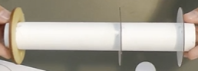
Step 2:
Assemble motor mount
Motor mount tube (A)
Cardboard centering ring (B)
Notched cardboard centering ring (C)
Wooden centering ring (P)
Eyebolt (Q)
Locknut (R)
Washers (S)
Pencil
Ruler
Drill with 1/8” bit
Pliers
Wood glue
Super glue (CA)
*Socket wrench (11/32)
*Optional

Slide 11
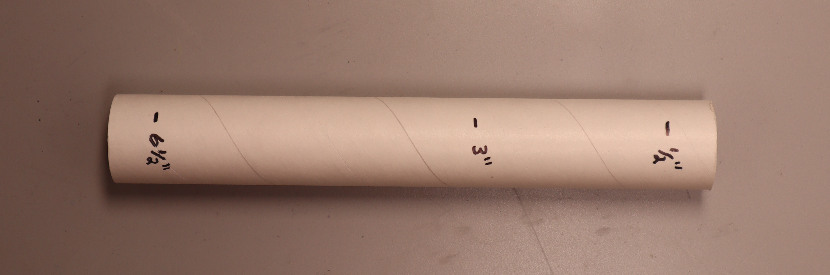
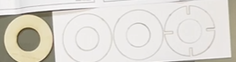
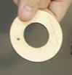
Step 2:
Assemble motor mount (cont’d)
2.1
Make a mark 1” from the end of the motor mount tube (A) and cut off the end. The resulting tube should be 7” long. (The 1” piece may be discarded.)
2.2
Using a pencil, mark the motor mount tube (A) at ½”, 3”, and 6 ½”.
2.3
Remove the notched centering ring (C) and one of the plain centering rings (B) from the cardboard sheet in the rocket kit. For stress purposes, we will use a wooden component (P) as our third centering ring.
Choose a location in the middle of the wooden ring width (P.) Drill a 1/8” hole through the ring.
P
B
C
3.2
c

Slide 12
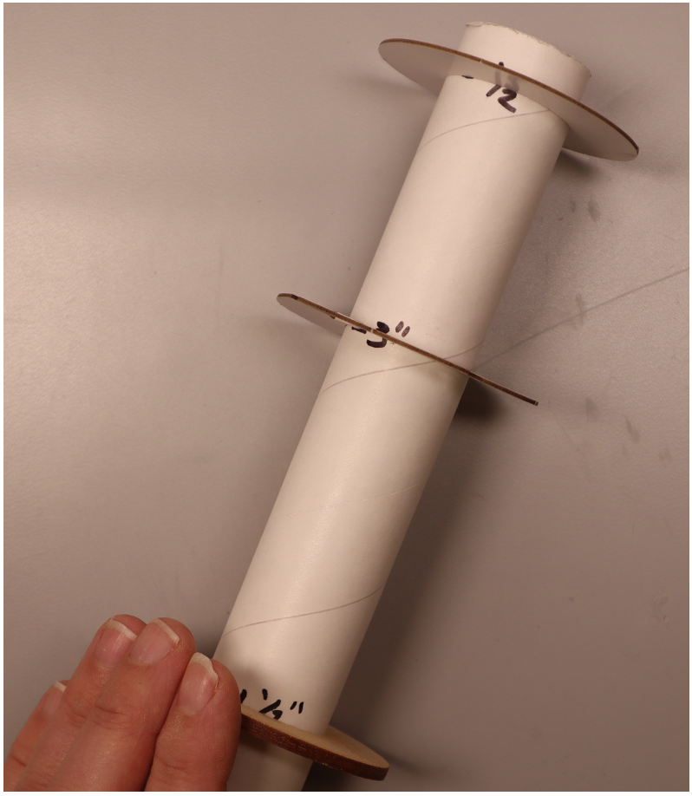
Step 2:
Assemble motor mount (cont’d)
2.4
Fit the wooden ring (P) on the 6 ½” mark of the motor mount tube (A) and fit the notched centering ring (C) at the 3” mark, and the plain cardboard centering ring (B) at the ½” mark.
*If the wooden centering ring seems too small, you may need to sand the inner circumference until it fits the motor mount tube.*
2.5
Once all centering rings are in their respective positions, place a bead of wood glue on the top of each circle where it meets the motor mount tube. Wait 15 to 30 minutes, flip the tube, and glue the bottom of each centering ring in same fashion. Allow the glue to dry another 15 to 30 minutes.

Slide 13
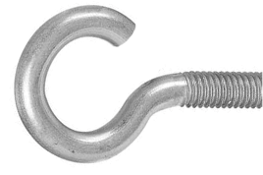
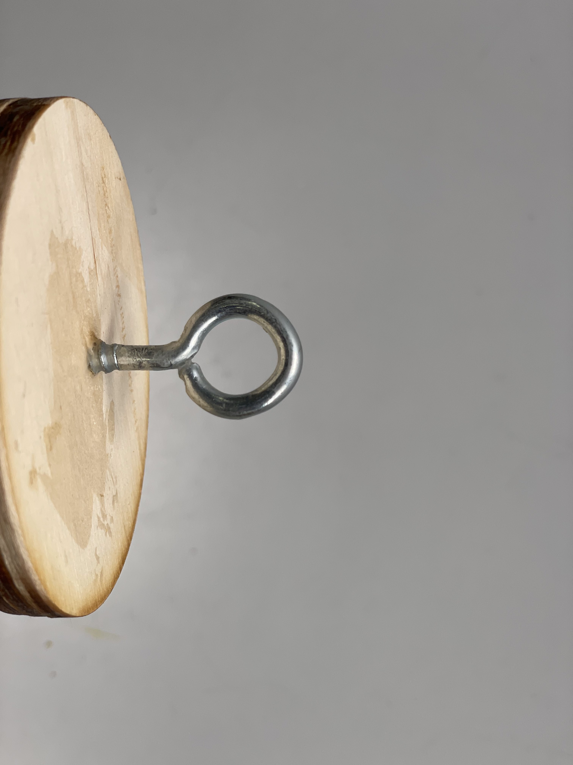

Step 2:
Assemble motor mount (cont’d)
2.6
Look closely at your eyebolt (Q). Use pliers to close any gap as much as possible and follow up with one or two drops of super glue to seal the connection. Before permanently installing the hardware, ensure that any gap in the eyebolt is closed.
Massive gap must be closed.
Failure to close this gap may cause the rocket’s recovery system to fail.
Closed gap has been sealed tight with superglue.
WARNING
2.7
Place one washer (R) on the top and one on the bottom of the 1/8” hole in the wooden ring and thread the eyebolt (Q) through the top, as shown.
Attach the locknut (S) from the bottom of the ring; you may need to use a deep socket to ensure the nut is fully tight to the ring.
When you are finished, the opening in the eyebolt should be perpendicular to the ring of the motor mount tube.

Slide 14
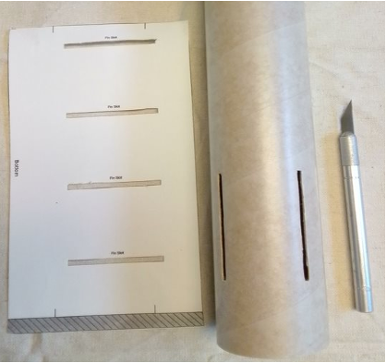
Step 3:
Prepare fin slots and install first rail button
Fin slot guide from Super Big Bertha instruction manual, p. 2
Body tube (D)
Ruler
Pencil
Painter’s or masking tape
Scissors
Craft or X-acto knife

Slide 15
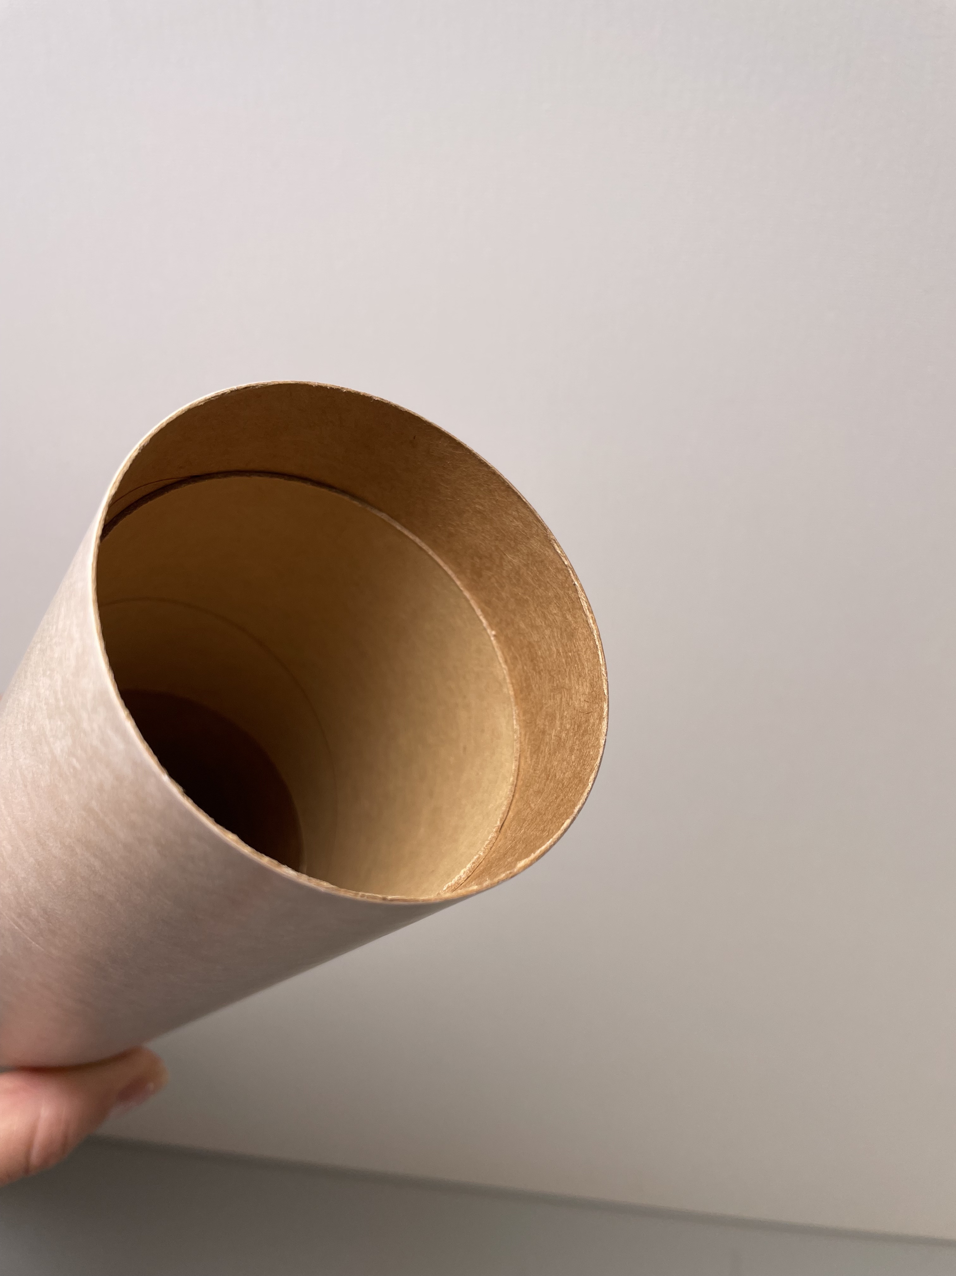
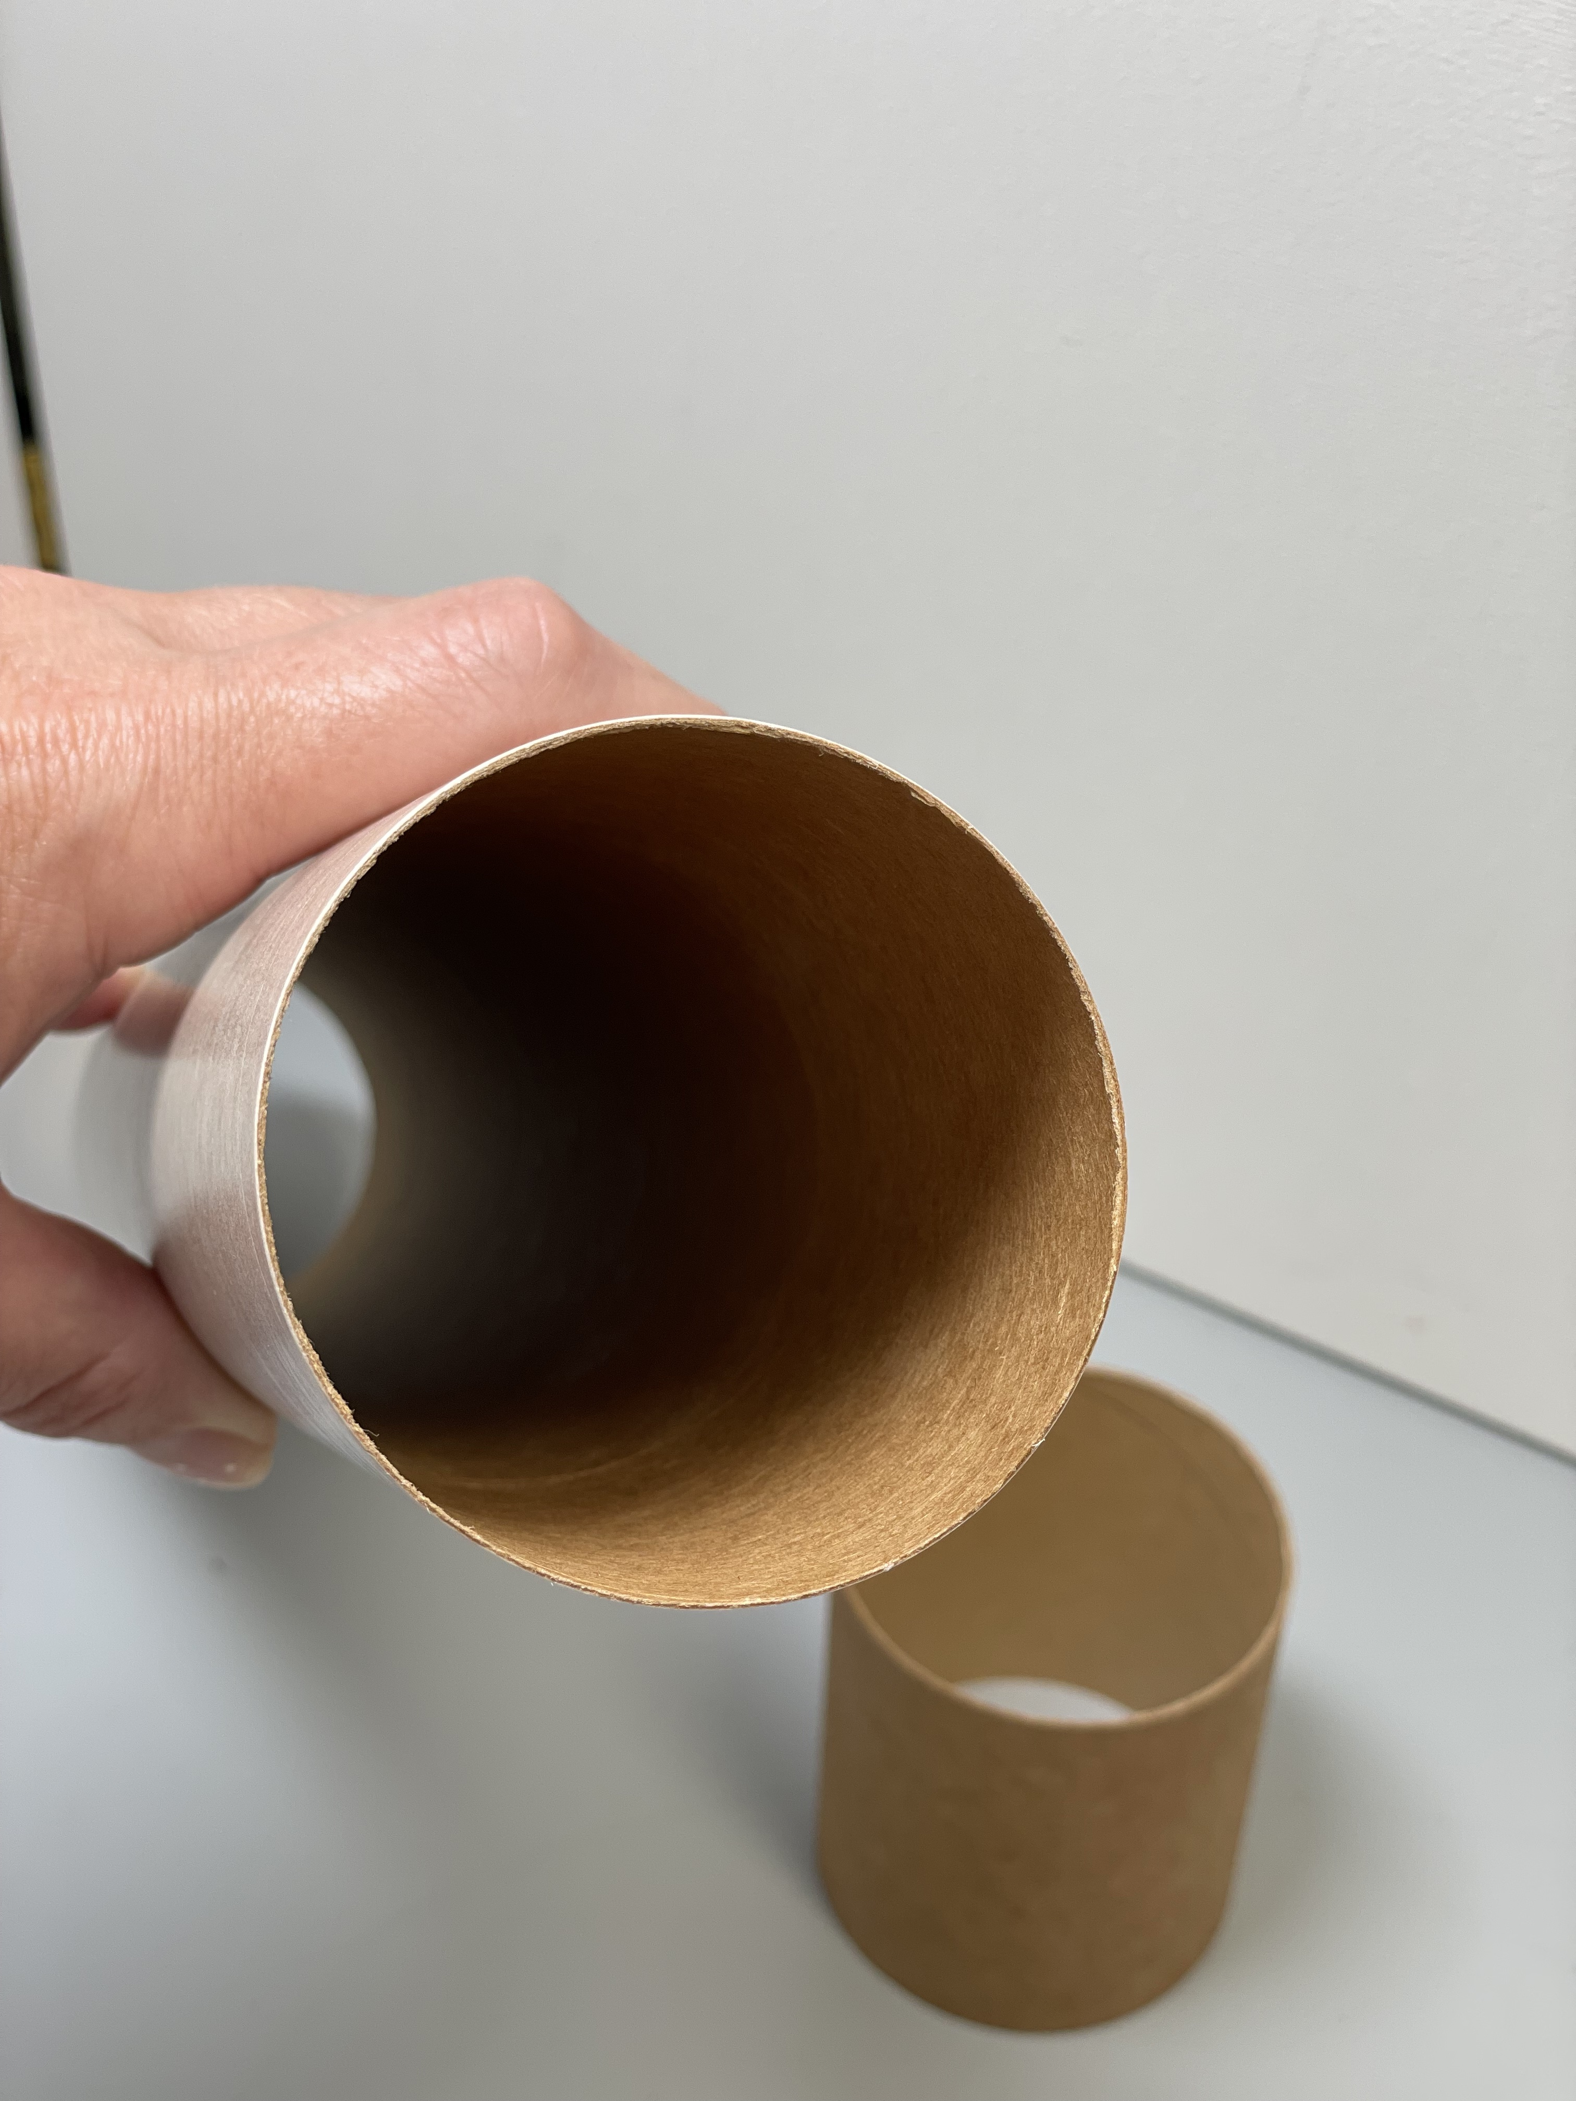
Step 3:
Prepare fin slots and install first rail button (cont’d)
3.1
Check the body tube (D). If the coupler (J) was stored inside the body tube for shipping, remove it now and set aside for Step 7.
This coupler must be removed before cutting the body tube.
3.2
Cut out the fin-slot guide sheet inside the instruction manual. Using masking or painter’s tape, Secure the bottom of the paper guide (marked “bottom”) 1” from the bottom of the second stage body tube (D) using masking or painter’s tape. There should be a 1” gap between the edge of the body tube and start of the paper.
1”
Adapted from Estes Super Big Bertha Model Rocket Instructions, Estes Industries, LLC, Penrose, CO, 2019, p. 2.

Slide 16
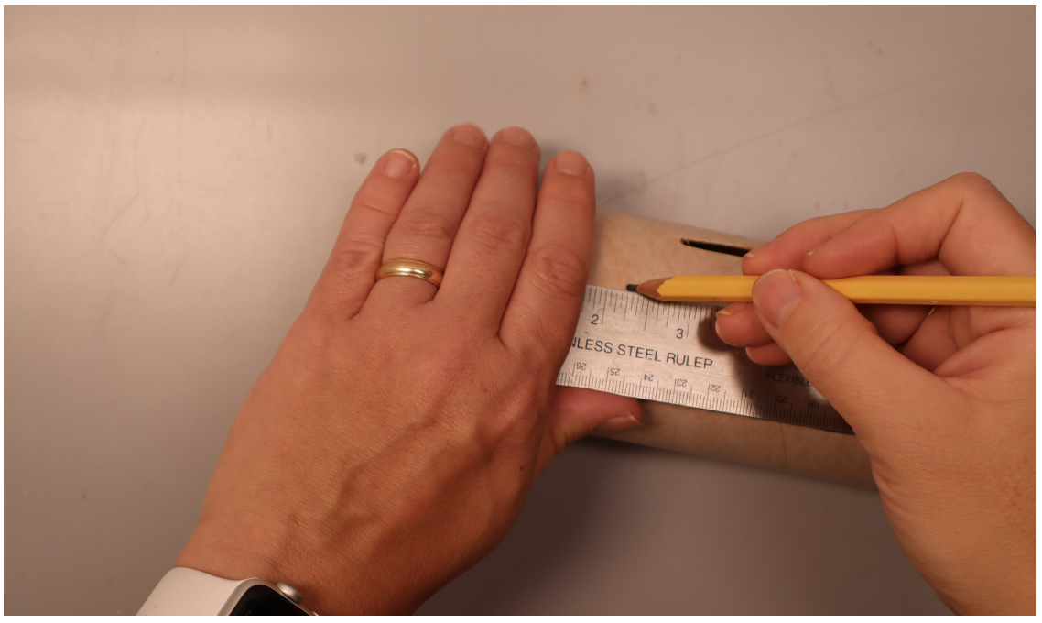
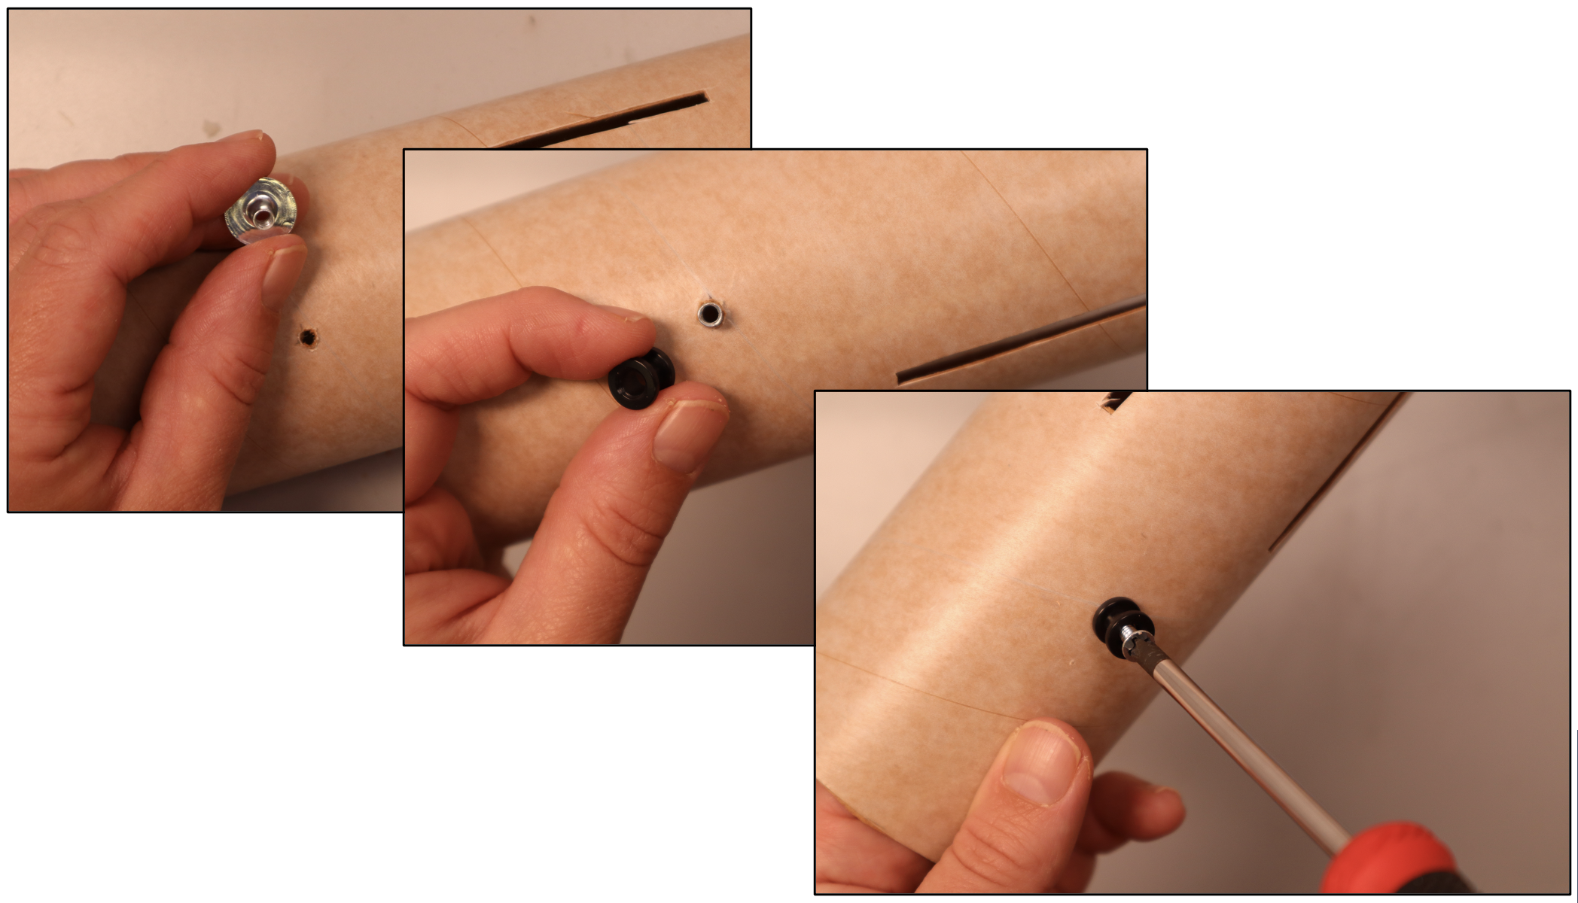
Step 3:
Prepare fin slots and install first rail button (cont’d)
3.3
Mid-way between two fin slots, measure 2 ¼” up from the bottom of the lower body tube and mark the location with pencil.
Drill a 5/32” hole at this location.
3.4
Separate the pieces of the rail button (BB). Insert the flanged weld-nut backing into the hole from the inside of the rocket body tube.
Place the nylon spacer around the weld nut on the outside, with the routed side facing outward.
Insert the screw and tighten.

Slide 17
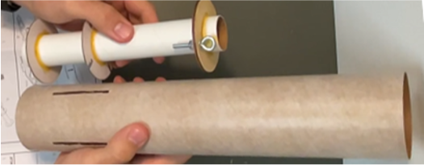
Step 4:
Install motor mount
Motor mount tube from step 2
Lower body tube from step 3
Fins from step 1
Pencil
Wood glue
Dowel rod (or waste balsa strip left over from step 1)

Slide 18
Step 4:
Install motor mount (cont’d)
4.1
Before installation, double check that the eyebolt gap has been closed and has been sealed tight with superglue.
If at this point you choose to attach the Kevlar shock cord to the eyebolt, you must ensure that:
1) The shock cord is sufficiently long. If it is too short, you will need to remove it and install a longer cord.
2) The shock cord is kept knot-free and protected from the glue used in the remainder of the build.
3) The knot used to secure the cord to the eyebolt is made far enough away from the eyebolt that it will be accessible outside the body tube once the motor mount is installed
Regardless of whether you install the shock cord now or after motor mount installation, you will need a system post-build to access the bolt for service.
Otherwise, shock cord installation is addressed in steps 12 and 13.
CAUTION

Slide 19
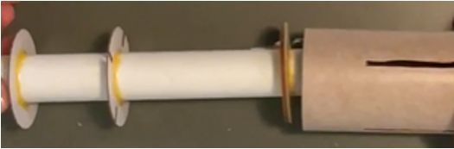
Step 4:
Install motor mount (cont’d)
4.2
First dry mount the motor mount. Insert the motor mount, wooden circle first, into the fin-slot end of the body tube from step 3, as shown in the image.
Double-check that the the eyebolt is visible from the top of the lower body tube.
Rotate the motor mount as needed to ensure that the slots in the middle cardboard centering ring are aligned with the fin slots in the body tube.
Rotate motor mount until notches in center ring align with fin notches in body tube.

Slide 20
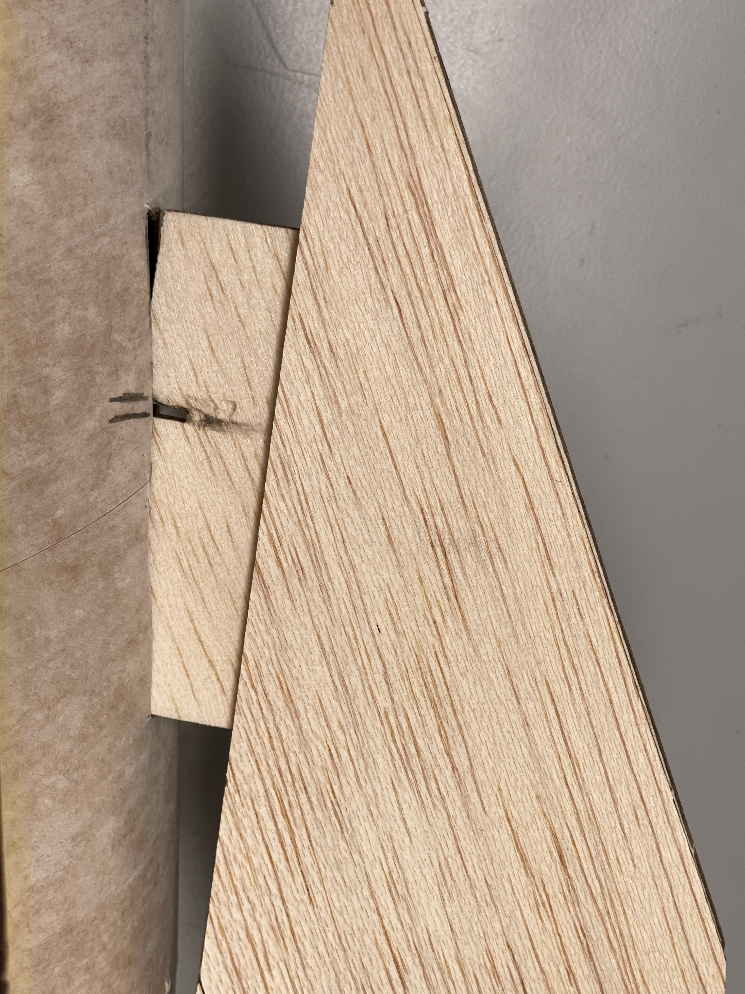
Step 4:
Install motor mount (cont’d)
4.3
Dry mount the fins in the fin slots to ensure proper alignment of the motor mount. If the fins do not insert fully/snugly, adjust the motor mount depth in the body tube until they do.
Carefully remove the fins only.
Using a pencil, mark the position on the body tube where the interior slotted cardboard centering ring crosses the fin slot. Make a mark where both the top and bottom of the cardboard centering ring cross the opening.
Adjust motor mount depth until fins fit snugly into the notches in the middle centering ring.
Mark on the body tube next to each fin slot where the center ring intersects with the fins.

Slide 21
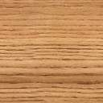
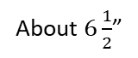
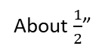
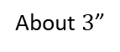
Step 4:
Install motor mount (cont’d)
4.4
Remove the motor mount and place next to the lower body tube at the depth you will eventually install it, using the marks you made as a guide. Use the dowel to measure the distance of the rings from the bottom of the lower body tube. Mark the distance of each ring on the dowel.
About $6\frac{1}{2}$”
About $3$”
About $\frac{1}{2}$”
4.5
Apply wood glue to the end of the balsa stick and insert it up to the deepest guide mark from step 4.4. At this depth apply a ring of wood glue inside the lower body tube.
Repeat the process of applying the glue ring with the next deepest mark on the guide stick until you have completed 3 glue rings inside the body tube.

Slide 22
Step 4:
Install motor mount (cont’d)
4.6
Insert the motor mount into the lower body tube, ensuring that the the eyebolt gap has been closed, the wooden ring goes in first, and that the eyebolt is facing the open upper end of the body tube.
Use the marks in made in step 4.3 as a guide for the necessary depth and ensure that the center ring’s notches align well with the fin slots in the body tube.

Slide 23
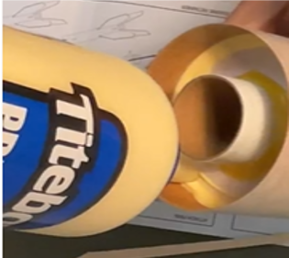
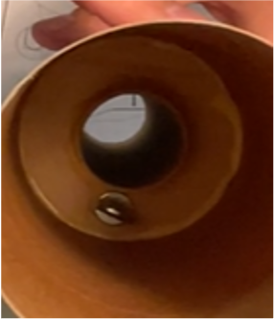
Step 4:
Install motor mount (cont’d)
4.7
Turn the body tube upside down and run another bead of wood glue around the outside circumference of the visible motor mount cardboard centering ring, filling any gaps between the centering ring and body tube. Allow a dry time of 15 to 30 minutes.
4.8
Set the body tube upright. Apply a dab of wood glue to one end of a dowel or long thin piece of waste balsa from step 1. Use this “glue stick” to reapply glue to the outside edge of the wooden centering ring, along the corner where it meets the outer cardboard tube. Make sure to fill in all gaps. Allow a dry time of 15 to 30 minutes.
Note: Avoid getting glue on eyebolt as it is very difficult to clean glue off this piece.

Slide 24
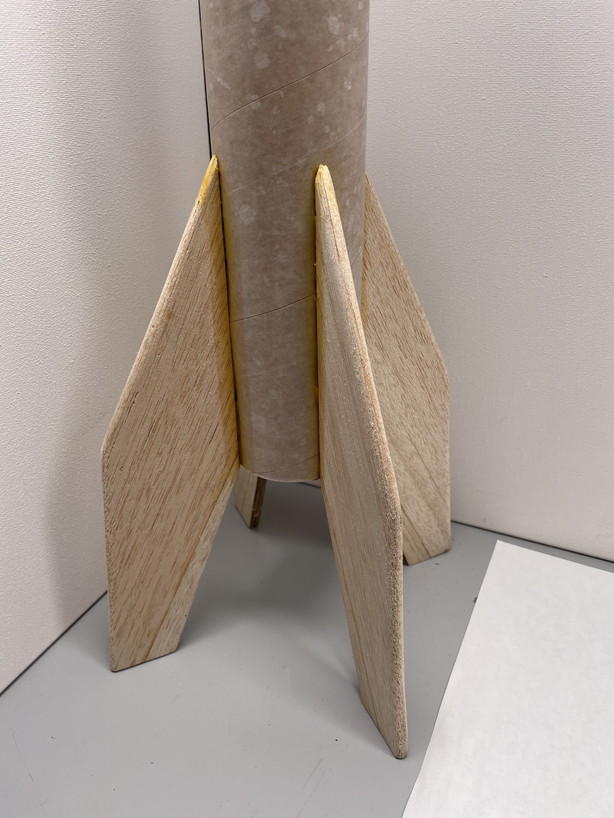
Step 5:
Attach fins
Lower body tube from step 4
Fins from step 1
Ruler
Pencil
Wood glue

Slide 25
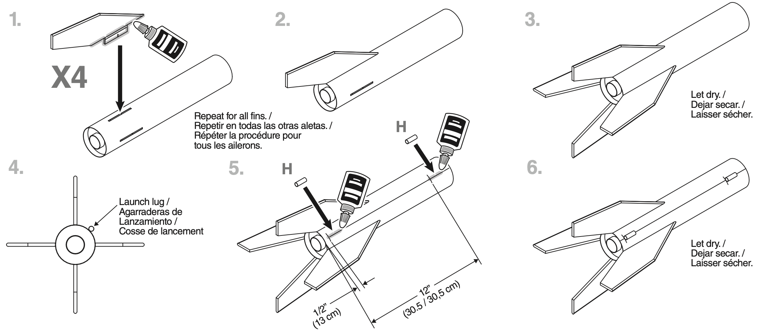
Step 5:
Attach fins
5.1
Attach fins and launch lugs as directed in the Estes kit instructions below.
Apply wood glue along the fin tab and the side edge where it will touch the body tube.
5.2
Laying the rocket body horizontal, place a fin into a fin slot, being careful to insert the fin tab into the slotted centering ring inside the rocket body.
Apply glue to any gap between the fin and the body, but ensure that excess glue does not drip down the rocket body.
Keeping the body tube horizontal, allow the glue to dry 10-15 min before rotating the tube and inserting the next fin.
Repeal for all fins and keep the body tube horizontal until the glue has dried.
Estes Super Big Bertha Model Rocket Instructions, Estes Industries, LLC, Penrose, CO, 2019, p. 4.

Slide 26
Step 5:
Attach fins and launch lugs (cont’d)
5.3
The launch lugs (H) will be applied halfway between two fins. Mark this location near the bottom of the lower body tube.
5.4
Along the position marked in step 5.3, measure ½” from the bottom of the body tube and mark the location. Strictly parallel to the body tube (perpendicular to the bottom of the tube), mark another location 12” up from the first.
Using wood glue, attach the launch lugs (H) at these two locations.
It is extremely important that when the rocket is placed vertical, these two launch lugs are strictly vertical and also in line with each other. If this is a challenge, use a piece of launch rod to ensure proper alignment until the glue is dry.
Estes Super Big Bertha Model Rocket Instructions, Estes Industries, LLC, Penrose, CO, 2019, p. 4.

Slide 27
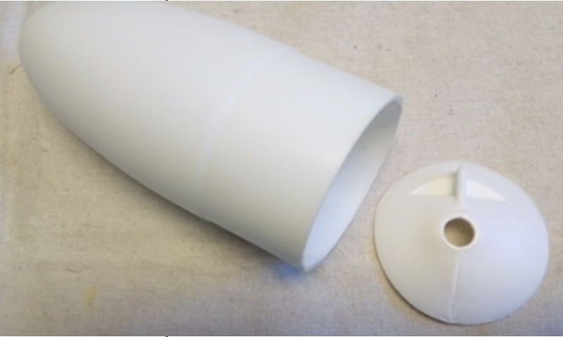
Step 6:
Cut the nose cone
Nosecone (J)
Craft or X-acto knife
-or-
Sandpaper
*Hacksaw and mitre box
*Clamps
*Optional

Slide 28
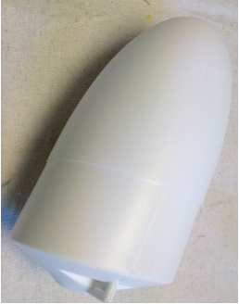
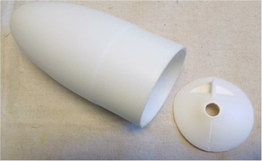
Step 6:
Cut the nose cone (cont’d)
6.1
The inside of the nose cone (J) is used to store our GPS antenna and, if desired, a mass-holder. The nose cone comes with a hard covering at the bottom which needs to be removed for this rocket build.
Using a craft knife, (or placing the nosecone in a mitre box secured with clamps using a hacksaw,) cut at the shoulder of the cylindrical section of the tube as shown. Be careful using sharp instruments on the unsteady nose cone. Discard the separated disk.
Cut across the tube at this shoulder.
6.2
Sand the trimmed edge of the nosecone so that the cut surface is flat.
May be
discarded
Sand this edge down after cutting.

Slide 29
Step 7:
Assemble body tubes
3 wooden bulkhead disks (with the eyebolt from one of the packages) (W)
Avionics bay (X)
Upper body tube (D)
Coupler (J)
Rail button (BB)
Sandpaper
Drill with 1/8” bit
Pliers
Pencil
Wood glue

Slide 30
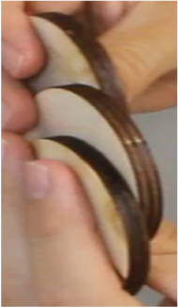


Step 7:
Assemble body tubes (cont’d)
7.1
To secure the two body tubes to one another, we need to add the coupler inside. However, we are NOT securing the coupler per kit instructions, instead positioning our payload in the upper body so that it will have very little freedom to move around during flight.
To begin we need to create a wooden bulkhead. Take three of the “Tube Bulkhead Disks” (W) shown to the right. Place the three plates together and glue them, taking care to ensure that they are perfectly aligned.
Put the body tube around the disks while they dry with a weight, such as your bottle of wood glue, on top of them to ensure the disks dry aligned correctly. Allow 15 to 30 minutes to dry.
If the bulkhead disks are not aligned correctly now, it is very tedious to sand them down to fit inside of the body tube later.

Slide 31


Step 7:
Assemble body tubes (cont’d)
7.2
Once the bulkhead is glued and dried, drill a 1/8” hole through the center of the disks using a 1/8” drill bit; this will accommodate the top eye bolt.
Use a 1/8” drill bit to drill the eye bolt hole here.
7.3
Use the bulkhead template provided at the end of these instructions to mark on the bulkhead where to make the GPS antenna hole.
With the hole marked, use a ½” drill bit to drill a hole all the way through the bulkhead.
7.4
Take one eyebolt from one of the bulkhead packages (W). Use pliers to close any gap in the eyebolt as much as possible and follow up with one or two drops of super glue to seal the connection. Before permanently installing the hardware, ensure that any gap in the eyebolt is closed.

Slide 32

Step 7:
Assemble body tubes (cont’d)
7.5
Install an eyebolt inside of the 1/8” center hole. Use pliers to tighten the eyebolt.
7.6
Gather the following items, which will be placed in this order from left to right:
Cut Nosecone
Electronics bay
Wooden Bulkhead
Coupler (I )
Place the nosecone into the upper body tube first. Next, insert the electronics bay. Finally, insert the wooden bulkhead with the eyebolt facing AWAY from the nosecone.

Slide 33


Step 7:
Assemble body tubes (cont’d)
7.7
Ensuring everything is fully seated towards the nosecone, place the coupler inside the upper body tube. Take a pencil and trace the edge of the coupler where it meets the bottom of the tube. Mark the exposed end of the coupler “bottom.”
Mark this side as “bottom”
7.8
Remove the coupler. Apply wood glue to the coupler around the side marked “bottom.”
Insert the glued coupler into the lower body tube, as deep as the pencil mark you made on the coupler. Allow 15 to 30 minutes to dry.
Note: the coupler is not glued to the top body tube.
The side marked “bottom” has been glued into the lower body tube, so the writing from step 7.7 is no longer visible.

Slide 34

Step 7:
Assemble the body tubes (cont’d)
7.9
Insert the flanged weld-nut backing into the hole from the inside of the rocket body tube.
Place the button around the weld nut on the outside, with the routed side facing outward.
Apply a dab of epoxy inside the weld nut threads, then insert the screw and tighten.

Slide 35

Step 7:
Assemble body tubes (cont’d)
7.10
Between two of the fins, in a bay immediately adjacent to the bay with the launch buttons, measure 4” up from the bottom edge of the tube and make a mark. Measure 2 ¼” up from the bottom edge of the tube and make a mark.
Using these marks as the bounds, draw a 1” high rectangle between the fins.
7.11
Use a craft knife to carefully cut through the body tube on three sides of this rectangle. This is the hatch through which you can add or adjust any masses for testing. The hatch can be closed for flight with painter’s tape.
Make a second hatch between the bays on the opposite side of the rocket (180° from this one).

Slide 36

Step 8:
Secure the nosecone
Nosecone from step 6
Upper body tube from step 7
Drill with 1/8” bit
Ruler
Pencil/Marker
(4) small screws (Y)
screwdriver

Slide 37

Step 8:
Secure the nosecone (cont’d)
8.1
Ensure the nose cone is fully seated in the upper body tube. While the nose cone is still seated, mark the tube ¾” back from where it meets the nose cone. Use a 1/8” drill bit to drill a hole through the tube and nose cone. Insert small screw (Y) to secure.
Repeat this process three more times at 90° intervals around the tube.
8.2
Make a mark on both the nosecone and upper body tube to show you how to realign the screw holes when the nosecone is removed to insert the avionics bay.

Slide 38

Step 9:
Secure wooden bulkhead to the upper body tube
Nose cone from step 8
Avionics bay (X)
Wooden bulkhead from step 7
3 long screws (Z)
Ruler
Pencil
Screwdriver

Slide 39

Step 9:
Secure wooden bulkhead to the upper body tube (cont’d)
9.1
Ensure all components in the upper body tube are still fully seated towards the nosecone. Measure the distance of the bulkhead to the end of the tube and add half the width of the bulkhead. Use this distance to mark the depth on the outside of the upper body tube.
Starting at the location immediately adjacent to the antenna hole in the bulkhead, mark an “X” on the depth line. Do not drill at this location!
From the ”X” mark three additional places around the circumference of the tube, approximately 90° apart. Using a 1/8” drill bit, drill a hole about ¼” shorter than the length of your long screws (Z), through the body tube and into the side of the bulkhead. Insert long screws (Z) to secure.

Slide 40

Step 10:
Install the motor retainer
Motor retainer set (K, L)
Avionics bay (X)
Sandpaper
Two-part epoxy
Lower body tube from step 7

Slide 41


Step 10:
Install the motor retainer (cont’d)
10.1
To install the motor retainer, use sandpaper to abrade the inside of the inner motor retainer ring.
Estes Super Big Bertha Model Rocket Instructions, Estes Industries, LLC, Penrose, CO, 2019, p. 4.
Two-part epoxy sets and dries very quickly, but the fumes are strong and should not be inhaled. Make sure to apply the epoxy and position the inner motor retainer ring quickly. Place the lower rocket body in a warm, well-ventilated location to cure.
CAUTION
10.2
Every epoxy brand will have its own directions and procedures. Working in a well-ventilated area, closely follow the directions for mixing your specific brand of epoxy.
Once the epoxy is ready to use, apply to the outside of the exposed end of the motor mount tube. Quickly place the inner motor retainer ring on the epoxied surface and allow to cure.

Slide 42

Step 11:
Rocket finishing
Spray paint
Masking or painter’s tape
Stencils
Stickers
*Optional

Slide 43

Step 11:
Rocket finishing (cont’d)
11.1
Have fun with designs on the rocket body! Use tape and stencils when spray painting to make your rocket colorful or even to add your school's logo. SIUE sure looks nice on there, doesn’t it. ☺
Make sure to tape off all interfaces (like the coupler and bottom of the nosecone (if exposed when painting).
Note: When using spray paint, work in a well-ventilated space. Be sure to put down protective covers on the surfaces where you are painting and be careful to avoid getting paint on yourself.
11.2
If you paint over the nosecone and body, make sure to re-mark the alignment of the nosecone as in step 8.2

Slide 44

Step 12:
Prepare flight system
Rocket body from step 10
Parachute (AA)
Shock cord (T)
Quick link (U)
Quick link (V)
Scissors

Slide 45
Step 12:
Prepare flight system (cont’d)
12.1
The length of the shock cord should be 3 times the length of the rocket body plus 6” to accommodate attaching the cord to the engine mount in the lower body. (The picture below shows the relative lengths needed.)
Cut the shock cord to the appropriate length.

Slide 46


Step 12:
Prepare flight system (cont’d)
12.2
Interlock the swivel and quick link as shown.
12.3
Attach the swivel to the shock cord approximately 1/3 of the way down one side of the shock cord.
Start by pulling one loop through the swivel ring.

Slide 47


Step 12:
Prepare flight system (cont’d)
12.4
Loop the back of the cord around the swivel head and pull the cord taut.
12.5
Pull the cord tight down around the ring.

Slide 48


Step 12:
Prepare flight system (cont’d)
12.6
Gather the shroud lines of the parachute. Most parachutes have 4 or more lines so be sure to include all of them. Extend the lines away from the parachute and tie a knotted loop in the bundle of lines, approximately 3” from the end of the cords.
12.7
Place the loop of parachute lines into the open quick link. Close the quick link and ensure it is tight.

Slide 49

Step 13:
Attach shock cord
Shock cord from step 12
Upper rocket body from step 9
Lower rocket body from step 10
Painter’s tape

Slide 50

Step 13:
Attach shock cord (cont’d)
13.1
Find the end of the Kevlar shock cord closer to the quick link. Attach this end of the cord to the eye bolt on the wooden bulkhead inside the upper body tube. Make a secure knot (we use square knots but any non-slip knot is fine), then cover the knot and the section of cord that comes into contact with the body tube with masking or painter’s tape.
13.2
Attach the other end of the shock cord to the eye bolt on the top of the motor mount. Working deep in the lower body tube can be tricky; long needle nose pliers can help you guide the cord and thread it through the eye bolt.
Once the cord is securely through the bolt, you can make the knot outside the body tube. Make a secure knot (a square knot or any other non-slip knot) and cover the knot and the section of cord that comes into contact with the body tube with masking or painter’s tape.

Slide 51

Step 14:
Prepare flight recovery
Parachute, swivel, and quick link assembly from step 12.
Recovery wadding

Slide 52




Step 14:
Prepare flight recovery (cont’d)
14.1
Take three sheets of recovery wadding to prepare the rocket for launch.
14.2
Place the first two pieces of recovery wadding inside the lower body tube up against the motor mount. Pull the Kevlar cord to the opposite side of the tube and place the last piece of recovery wadding inside the tube.
Be sure to space the sheets out well, leaving no gaps inside of the tube. Ensure that you cannot see the motor mount tube to protect your parachute from taking damage during flight.
14.3
Neatly coil (but do not tie) the lower 2/3 of the Kevlar shock cord on top of the recovery wading as shown.
Do not make the coil too tight or it will not properly deploy.

Slide 53

Step 14:
Prepare flight recovery
14.4
Detach the parachute from the shock cord using the quick link.
Lay the parachute on a flat surface and gather it such that the shroud lines are all lined up at the bottom of the parachute and can be bundled together neatly.
14.5
Make a ‘U’ shape with the shroud lines as shown, ensuring that the quick link stays at the edge of the parachute.
14.6
Fold the bottom edge of the parachute 2/3 of the way up towards the top edge (Picture A). Fold the top edge of the parachute down to meet with the bottom folded edge. (Picture B) Ensure that the quick link is still accessible from the end of the parachute.

Slide 54

Step 14:
Prepare flight recovery (cont’d)
14.7
From the left (closed) end of the parachute, make a fold to the right at about 1/6 of the length of the parachute.
14.8
From the left side again, make another fold to the right at about 1/5 of the remaining length of the parachute.

Slide 55

Step 14:
Prepare flight recovery (cont’d)
14.9
From the right side, make a fold towards the left at about 1/4 the length the parachute.
Be sure that the quick link remains accessible outside the folded parachute.
14.10
From the right side, make a fold underneath the open edge of the fold from step 14.6.
The folded sides should now be touching.

Slide 56

Step 14:
Prepare flight recovery (cont’d)
14.11
Fold in half one final time, ensuring that the quick link is still accessible from outside the folded parachute.
14.12
Carefully insert the folded parachute into the lower body tube.
Loosely coil the remaining Kevlar cord on top of the parachute.

Slide 57

Step 14:
Prepare flight recovery (cont’d)
14.13
Take the two rocket halves and connect them as shown. The gap between the body tubes should be minimal.
If it is a tight fit, ensure the shock cord is not in the way of the tube. If no cords are in the way and there is still a tight fit, the packed parachute is too long; unravel the parachute and fold it again tighter.

Slide 58

Step 15:
Install motor and prepare for launch
Completed rocket body from step 14
Appropriate solid rocket motor and ignitor. (Instructions for the F15-4 and F67-4 are shown here. For any other motor you have previously modeled, follow the motor instructions.)
Painter’s tape

Slide 59
Step 15:
Install motor and prepare for launch (cont’d)
If using an Estes F15-4, proceed with step 15.1
If using an Aerotech F67-4 motor, skip to step 15.5.
If you are using any other previously modeled rocket motor, follow the motor manufacturer’s instructions.
CAUTION
Steps 15.1 to 15.2 and 15.5 should only be completed once you are out in the field, preparing to launch.
Steps 15.3 to 15.4 and 15.6 to 15.8 should only be completed once your rocket is on the launchstand, ready to launch.
Failure to follow these instructions or insertion of the motor and/or ignitors before indicated may result in serious harm.
WARNING

Slide 60


Step 15:
Install motor and prepare for launch (cont’d)
15.1
In the field: For the Estes F-15, wrap a 1/4”-3/8” wide strip of masking or duct tape around the nozzle-end of the motor. Wrap around the cardboard 4-6 times until you have created a raised lip.
If there is any excess tape extending beyond the end of the motor, trim it off with a craft or X-acto knife.
15.2
In the field: Insert the motor into the motor mount tube and screw on the outer retainer ring to secure.
Estes Super Big Bertha Model Rocket Instructions, Estes Industries, LLC, Penrose, CO, 2019, p. 5.

Slide 61

Step 15:
Install motor and prepare for launch (cont’d)
15.3
On the launchstand: Do not remove the paper from the F15-4 ignitor. Carefully insert the treated end of the ignitor fully into the nozzle of the motor. The tip must be touching the propellant for ignition.
15.4
On the launchstand: With the ignitor in place, fully insert a plastic plug into the nozzle. The cap should be flat against the nozzle.
Estes Super Big Bertha Model Rocket Instructions, Estes Industries, LLC, Penrose, CO, 2019, p. 5.

Slide 62

Step 15:
Install motor and prepare for launch (cont’d)
15.5
If using the F67-4:
The F67 is fabricated with a built-in thrust ring, so you don’t need to make one using tape.
In the field: Carefully insert the motor into the motor mount tube and screw on the outer retainer ring to secure.
15.6
On the launchstand: If the wires of the ignitor supplied with the motor are not stripped at the ends, strip about ½” length of insulation off the ends of the wires.

Slide 63

Step 15:
Install motor and prepare for launch (cont’d)
15.7
On the launchstand: Insert the chemically treated end of the ignitor into the nozzle, all the way up until it cannot go any further (about 3 ½”). Do not force the wires up further as it could damage the ignitor.
15.8
On the launchstand: Fold the wire outside to conform to the shape of the nozzle.
Wrap a ½” strip of masking, painter’s or duct tape over the ignitor and around the outside of the nozzle as shown

Slide 64

Congratulations!
Your rocket build is finished and you are ready for launch!

Slide 65

Template
Measurements are in mm

